Slide 1
TypeScript
Varun Kumar
TS Video tutorial - https://www.youtube.com/watch?v=30LWjhZzg50

Slide 2
Prerequisites
JS
ES

Slide 3
JS
TS
Notes:
Typescript is the superset of the Javascript that means, what you can do in javascript can also be done in Typescript and a lot more things available.

Slide 4
Agenda
What is TypeScript?
When and Why use Typescript?
Setting up development environment.
Creating hello world program in Typescript
Configuring the Typescript Compiler
Debugging Typescript Application.
Fundamental of Typescript

Slide 5
What is TypeScript?
Typescript is a programming language created by Microsoft to address that shortcomings of JS.
We can think away it like Brother or the sister of Javascript
How it is different from Javascript?
Javascript is like a kid without any discipline who does whatever he or she wants.
Typescript on the other hand is like a kid with discipline.
Technically TS is build on top of JS, so every JS file is valid TS file.
Notes:
Typescript is all about type safety and nothing more.
What is type safety and example.
It is a transpiled language. Transpiler convert code from one language to another language

Slide 6
When and Why use TS?
Typescript add some cool feature to JS that helps us to build more robust and maintainable applications in less time.
Benefits -
Static typing - Most Important
Code completion
Refactoring
Shorthand notations
Notes:
Types of Languages
1. Statically Typed
2. Dynamically Typed
Statically Typed
In this type of language like CPP, C#, JAVA we know the type of Variable at compile time or while coding.
Eg - we can declare integer like this
int age = 21; // now this variable can only held integer value nothing else.
We cannot set it to any string or any other type of data.
Dynamically Typed
In this type of languages like JS, Python, Ruby the type of variable is dynamic. So it is determine at runtime and it can also changed.
so we can declare a variable and set it to a integer
let age = 21;
age = 'Twenty One';
This variable does not have a fix data type. And type is determined at runtime and may changed during execution.
This is great and provide a lot of flexibility but it also causes the problem.
Problems it Causes
What if we passes this variable in to a function that expects a number then our application might misbehaves or crash. Problem is that we will not encounter this issue until we run our application or unit tests.
We need to test every function with various edge cases to find these bugs and this is a problem that TS try to solve.
Eg-
Math.round(age);
Typescript is essentially Javascript with type checking.
Transpiler
With TS set type at time of declaration just how we code in statically typed languages. then it passes the code to TS compiler and compiler inform us if we are doing some wrong so we catch a lot of our mistakes at compile time.
So if we declare a variable as number
let y : number = 10;
we can't set it to string
number = 'x'; // will give error
TS compiler will give error at compile time and we easily get to know the reason.
TS is a more than just type checking. More code editor have a great support for TS so they can detect type of variables and our productivity boosting feature like code completion and refactoring.
Additionally TS Provides more features that gives us ability to write more cleaner and concise code.
Over the time these features can be added to JS but as we have various browsers and runtime environment for executing JS code it take some time until these features are implemented in various browsers.
We can do anything with TS that can be done with JS. like frontend and backend.

Slide 7
Drawbacks
TS compilation step involves.
At this time browser don't understand our TS code so we give our code to TS compiler and it gives us JS code. This process is called Transpilation.
We have to add more discipline while writing the TS code.
TS - Medium to large projects
JS - Simple projects
Notes:
With TS we can build the scalable projects that are easy to maintain.

Slide 8
Setup Development Environment
Install node with npm
Install typescript using npm
npm install typescript -g --save (install globally so that it can be accessed from anywhere)
Check the version
tsc -v
Write down a hello world program and execute it.
let age: number = 10; // hello.js
Compile it
tsc hello.ts
Execute it
node hello.js

Slide 9

Configure TS Compiler
Create config file
tsc --init
Check for the file tsconfig.json
target
This is used to set target jS version.
Depending on where you are going to deploy your application we can choose JS version.
module
Set to commonjs

Slide 10
continue…
rootdir
This specify the root directory of project here we can give ./
If we move index.ts into src folder then we can change rootdir to './src'
outdir
Under the EMIT we have outdir which will contain our js files.
outdir: './dist'
When we compile our code using TS compiler our JS code is going to be stored in this folder.
remove comment
TS compiler will remove all the comments in JS conversion.
Noemitonerror
If there is some error in TS code, compiler still generate JS file, so if we don't want to do that, enable this config.

Slide 11
Debugging TS application
We can debug our code line by line.
In tsconfig enable sourcemap .
It is file that specifies how each line of our TS code is maps to the generated JS code.
Recompile our code
In dist folder a new file is there index.js.map
The code defines how TS code is mapped to JS code
This is not for us to understand. it is for debuggers.

Slide 12
continue…
Click on the first line to insert a breakpoint.
When we start debugging execution stop right at this point.
From this point we can execute our code line by line.
Go to the debug panel and click on launch a json file
From the dropdown select the node.js
It will create a new file called launch.json
This is a file with some config that tells our debugger how to debug our code.
Use node to launch the program and here we have label Launch Program
And we can see our program starts here from index file and also we can see our output dir

Slide 13
continue…
Add one more setting preLaunchTask and in this we add this value 'tsc: build - tsconfig.json'
Using this line of code we are telling vs code to use tsc to build our application using this config file.
Now to debug go to debug panel and click on launch program.
Now program started and it will stop at breakpoint and here we can see how its flow goes.
We just check this step over which executes line one by one.
On the left hand side under variables we can see the variables and their values.
Here under watch you can add variable whose value you want to check like how it is getting changed.

Slide 14
Fundamental of TS
Built in data type
JS Builtin Type
Boolean
Number
String
Null
Undefined
Object
With TS new added
Enum
Tuple
Any
Never
Unknown
Other Features -
Arrays
Tuples
Enums
Functions and arrow functions
Classes and inheritance
Interfaces

Slide 15
Variable Declarations
let age = 18
const title = ‘TypeScript’

Slide 16
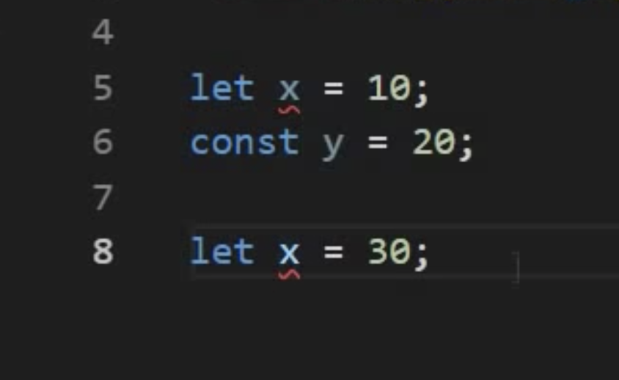
Variable Declarations
Can not redeclare block-scoped variable x

Slide 17
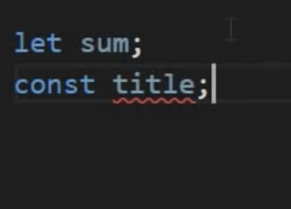
Variable Declarations
Const declaration must be initialized const title = ‘typescript’

Slide 18
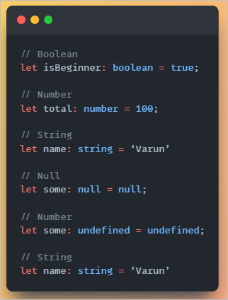
Variable Types
These variable can be initialized by null or undefined also
Digits of large number can be separated by underscore.
In TS we always not needed to add type annotation because TS compiler can easily detect the type of variable based on their value.

Slide 19
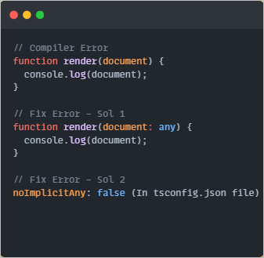
Any Type
Represents any type of data
If we declare a variable but don't initialize it, TS assumes it as any type.
We can change its value at any point of time in code. It's not useful as we use TS due to its type safety. So if we use this any type we lose the major feature of TS.

Slide 20
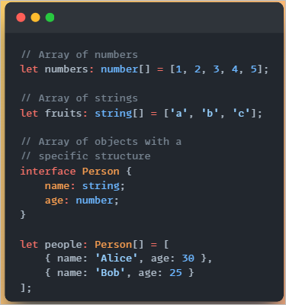
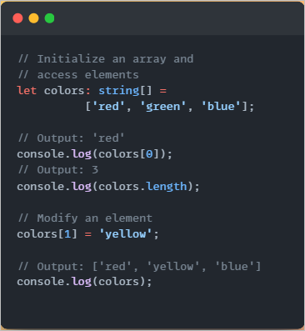
Arrays

Slide 21
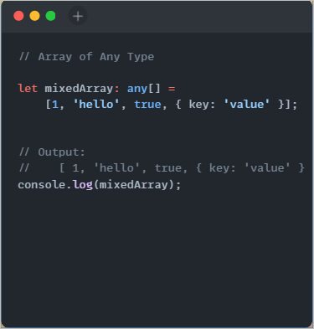
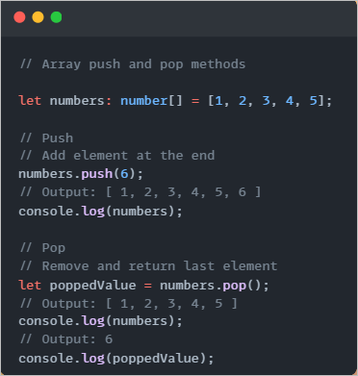
Arrays

Slide 22
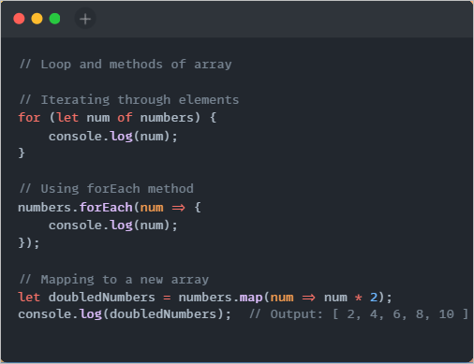
Arrays

Slide 23
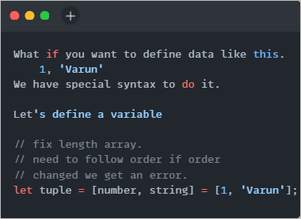
Tuple
Tuple is like an array with fixed length.
Tuples are useful when we have two values like key value.
It get converted into regular JS array.
Here we have one problem with push method. so If i use tuple.push(1)
Compiler is not going to give us an error.

Slide 24
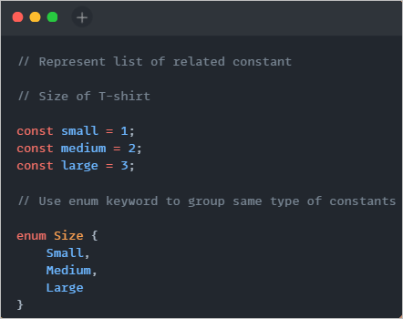
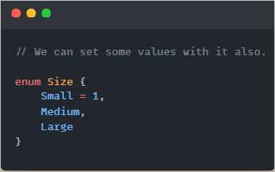
Enum

Slide 25
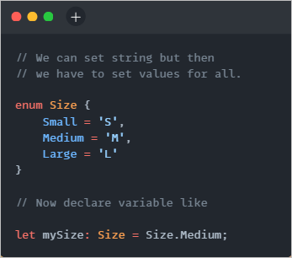
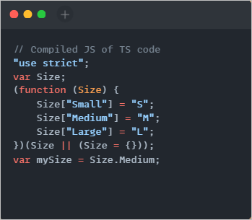
Enum

Slide 26
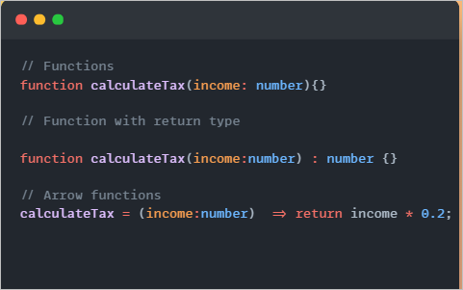
Functions
We can make parameters optional or can given default values
If we make parameter optional we have to check if it have valid value or not.

Slide 27
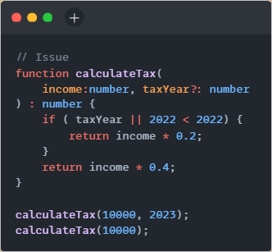
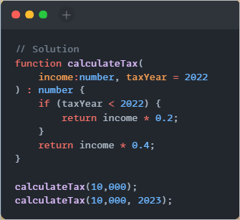
Functions

Slide 28
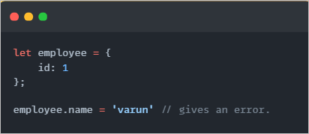
Objects
In JS objects were dynamic so we are able to add new properties dynamically but in TS it is not allowed.

Slide 29
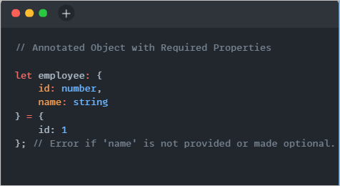
Objects
Type Annotation: Ensures required properties are defined.

Slide 30
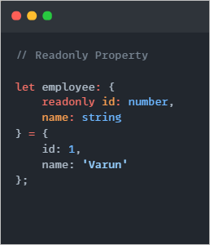
Objects
Readonly Property: Values cannot be modified after initialization.

Slide 31
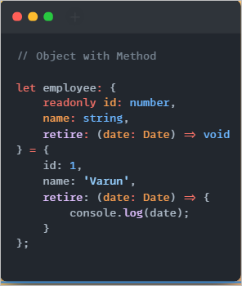
Objects
Method Definition: Declaring a method within an object.

Slide 32
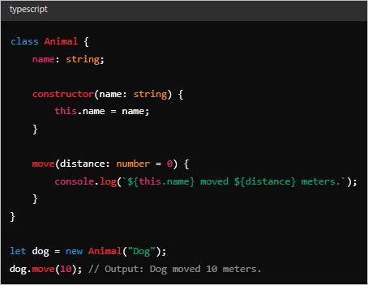
Class
Classes are blueprints for creating objects in TypeScript, encapsulating properties and methods.
Facilitate object-oriented programming, promoting code reusability and structure.

Slide 33
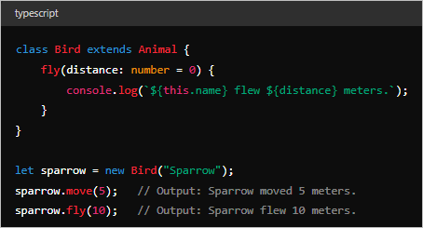
Inheritance in TypeScript
Inheritance allows a class (subclass) to inherit properties and methods from another class (superclass).
Syntax: class Subclass extends Superclass { ... }

Slide 34
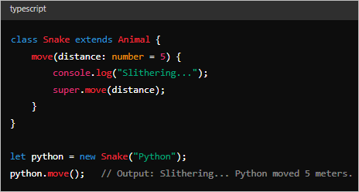
Overriding Methods

Slide 35
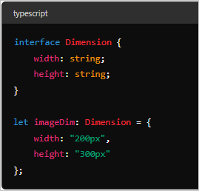
Interface
Interfaces describe the structure of objects, specifying property names and their corresponding types.
Provide type-checking during development and ensure consistency in object shapes.

Slide 36
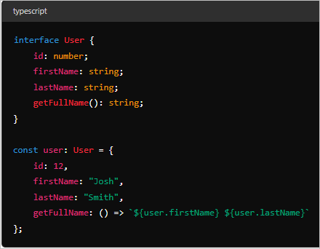
Interface with methods
Shows an interface User with properties (id, firstName, lastName) and a method (getFullName) returning a string.

Slide 37
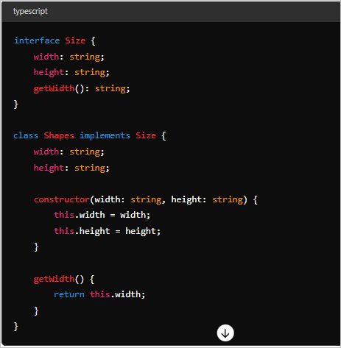
Interface with Class Implementation
Illustrates how interfaces can be implemented in classes (Shapes), ensuring adherence to interface specifications (Size).

Slide 38
Access Modifiers
Private - accessible within the class only
Protected - accessible within the class and the derived classes also
Public - accessible to public

Slide 39
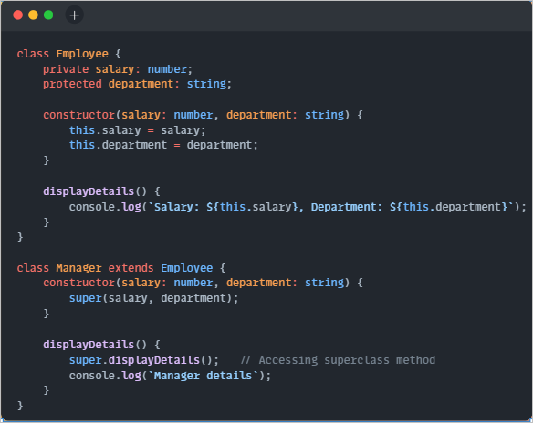
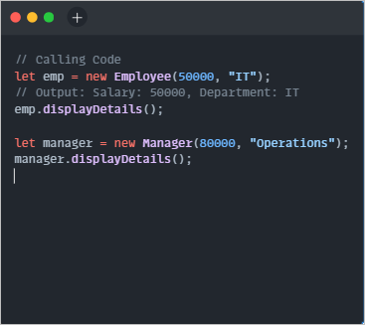
Access Modifiers

Slide 40


